Slide 1
ETL
Process
With Tableau

Slide 2
Dataset
On PostreSQL
Table Orders
51.290 Rows - 24 Fields
Table Returns
1.174 Rows - 3 Fields
Table People
14 Rows - 2 Fields
Superstore Dataset
The superstore dataset is a collection of data that stores information about product sales at a fictional company

Slide 3



ETL PROCESS
Transoform
Extract
Load
Analyze
Source
Data Warehouse
PostgreSQL
Python Notebook
PostgreSQL

Slide 4
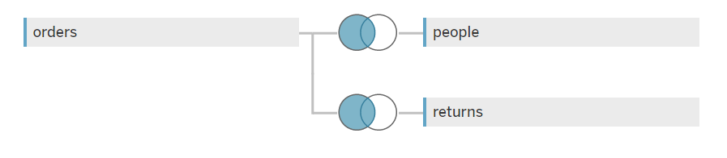
Tableau
Left Join Data

Slide 5
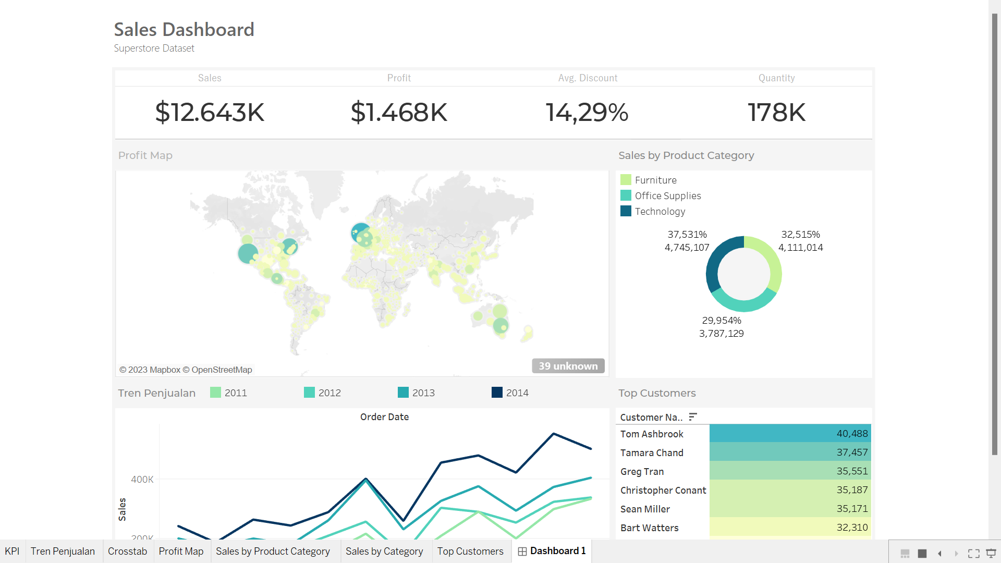
Tableau Dashboard
In general, sales have been good. However, in several sector areas and categories there are problematic sales

Slide 6
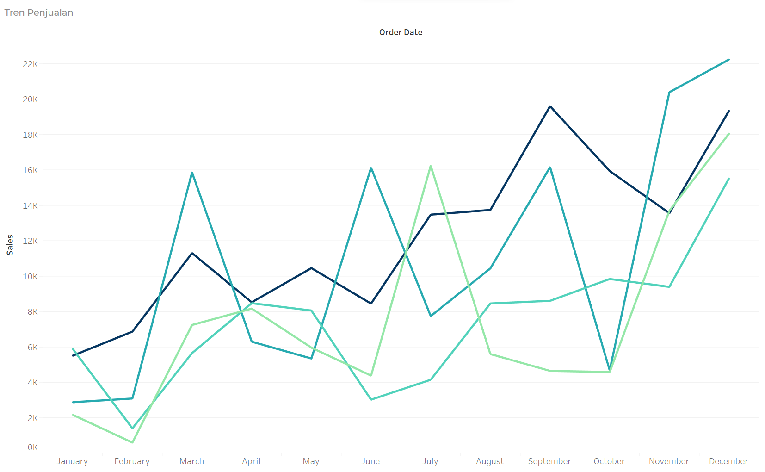
Sales Trend
Sales at the beginning of the year are always low, while inthe end of the year sales will increase

Slide 7
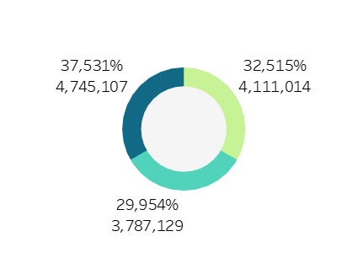
Sales by Product Category
Sales by Product Category evenly distributed

Slide 8
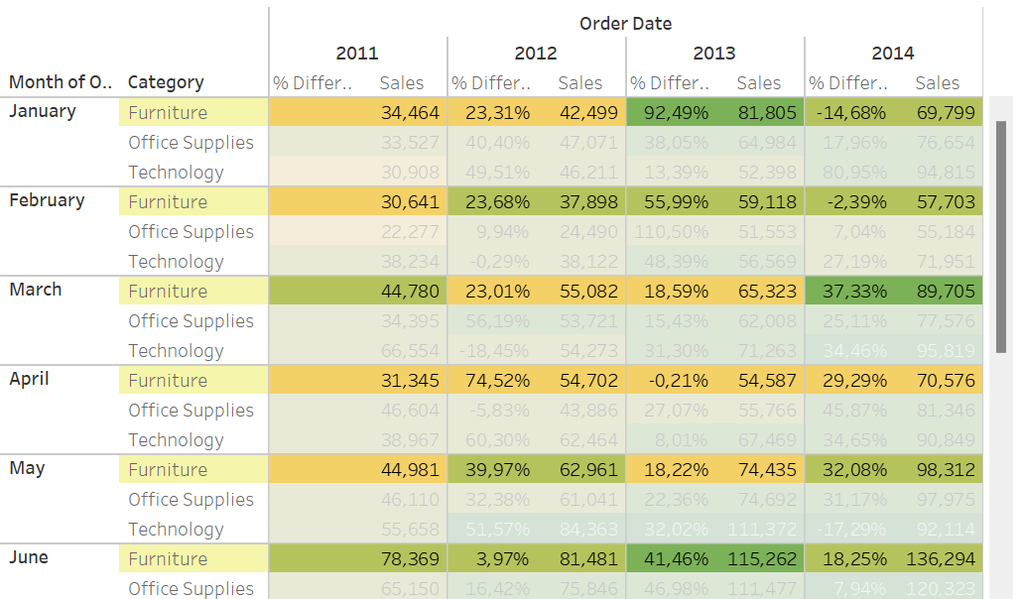
Worst Product Category
The furniture category is the category that has the lowest profit
from year to year

Slide 9
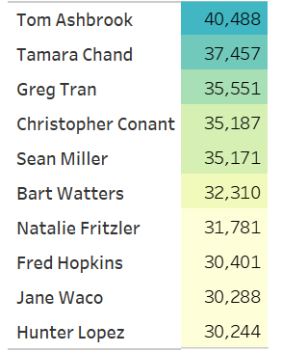
Our Top Customer

Slide 10



Thanks!
Click!

